Slide 1
Before we start…
If you are not on Slack, you should probably be on Slack.
Don’t leave me hanging.
If your team has 5 members, contact me immediately, you’re going to be dissolved.
If your team has 6 members, good news, message me.
Did you read my e-mail from yesterday? I hope so.

Slide 2
Before we start…
We will start reviewing your proposals tomorrow.
If it’s good-to-go, we’ll be in touch shortly
If “it’s complicated”, you will be assigned your project next week
Don’t ever hesitate to contact me or your TA.
I’ll lurk your Slacks during weekdays
I like Slack
I like it when you mention me on Slack.
Did I mention that I like Slack?
After your initial meeting, though, use your TAs as much as possible – they will be monitoring your progress more closely

Slide 3
Before we start…
Next ~3 weeks is design stage.
This means we need to cover:
Design Patterns (MVC and related)
UML
Getting Started with Grails (including a tutorial)
After that:
Git and GitHub (definitely a tutorial)
User Interfaces (including, probably, a couple of tutorials)
Other curriculum material we need to do
Development methodologies, project management
i.e. the ultimate big business buzzword extravaganza

Slide 4
Stage 1

Slide 5
Software Project Design
Due Friday February 10th at Midnight
Stage 1 is the culmination of your project’s design.

Slide 6
Components
Team Website
UML Class Diagram
User Stories and Tasks

Slide 7
Team Website
Home Page
Team Roster Page
Software Design Page
UI Design Page
Project Plan Page

Slide 8
Home Page
Team name and number
Brief description of your project

Slide 9
Team Roster Page
List of team members
Each member’s skills/background/hobbies/philosophy/whatever
Primary role on team
e.g. Code Champion, Repo Hero, Database Ace, Team Overseer, UX Guru, etc.

Slide 10
Software Design Page
UML Class Diagram
More details to be added later.

Slide 11
UI Design Page
Look and feel / design language
e.g. flat design, minimal, Material Design, etc.
You can cite existing software as inspiration
High-level description of intended user interactions
How does the user navigate between screens?
Summarize the most typical use case / workflow
UI Mockups
Graphic representing each user interface view
Use of software recommended
Make sure all user stories are covered

Slide 12
Project Plan Page
Your returned project proposals will likely include
Most of the features you originally proposed
Requested, under specified features you need to elaborate
For all features (original and requested) you must include
Title
Description (brief)
Feasibility statement and implementation plan
Statement of dependency
i.e. whether/how other features depend on this one

Slide 13
UML Class Diagram
Don’t worry, we’ll review this.
Regardless of your project’s framework (Grails, Vanilla Java, Android, Angular, React, etc…)
State the high level design pattern your project is following
Don’t worry, we’ll introduce this.
Class names, relationships, instance variables, methods
You can generate UML class diagrams using software
DO NOT INCLUDE USER INTERFACE CLASSES
But do include any classes that respond to your UI
These are the ‘C’ in MVC

Slide 14
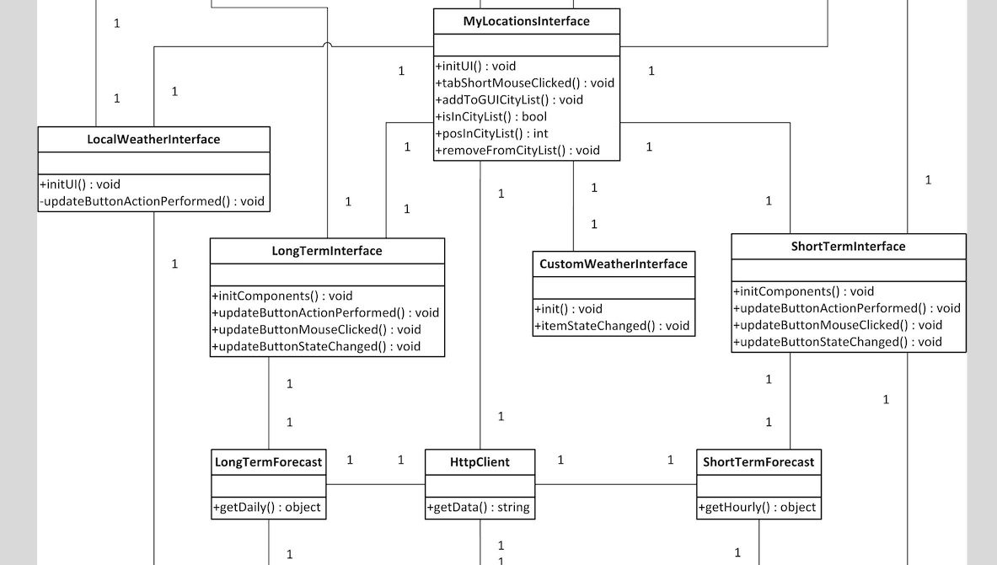

Slide 15
User Stories and Tasks
Basically, your Project Plan Page implemented using a project management tool.
You can use GitHub for this!
Every user feature should be reflected by a user story including
The story itself
Any acceptance criteria
Assigned team member(s)
Associated Milestone with Due Date (if applicable)

Slide 17
For more details, find the Stage 1 description on the course website!

Slide 18
Primer on MVC and Grails
Today: Motivation
Friday: More on MVC, Grails*, UML, etc.

Slide 19
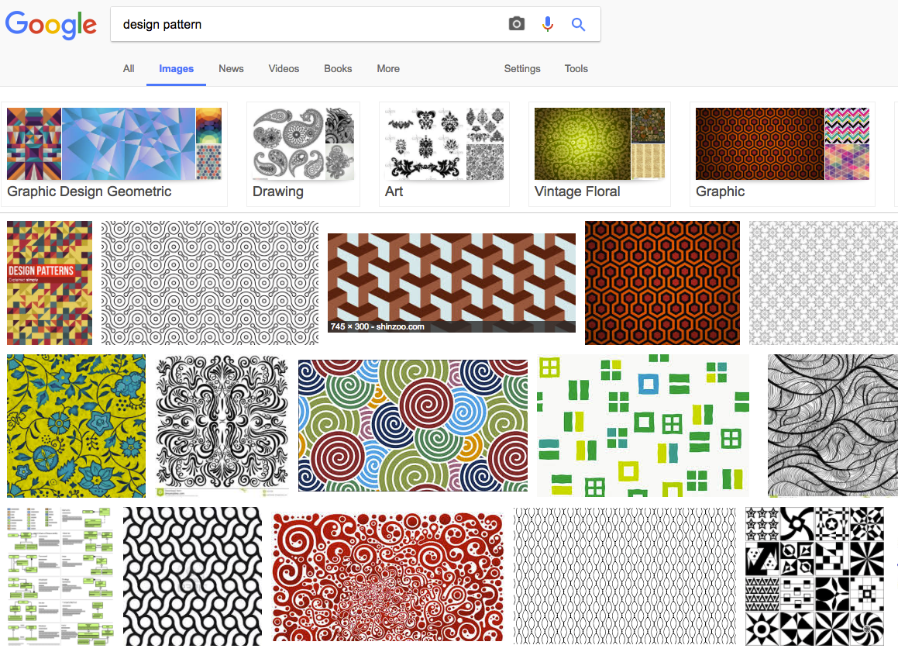
What is a design pattern?

Slide 20
What is a design pattern?
…not that.
Design patterns are abstract code organization solutions.
They help with:
Maintainability
Code Reuse
Separation of Concerns
Security
Resource Management
Communication

Slide 21
Why are we learning this?
Design patterns are ubiquitous in OO-programming.
MUCH more on this next year
In this course, we will build on the concepts of class hierarchies and modularity to write thoughtfully organized code.
At the highest level, we will consider the MVC design pattern.
MVC framework skills are in (very) high demand
Even if your project is in plain Java, you will benefit from a basic knowledge of MVC.
Notes:
WRT MVC – I was totally unprepared for my first day working in a startup. I wish MVC had been covered in a second year course!

Slide 22
What is MVC?
Definitions and explanations
of MVC are inconsistent.
MVC = Model View Controller
https://en.wikipedia.org/wiki/Model%E2%80%93view%E2%80%93controller

Slide 23
Model
Represents your data, logic, and rules.
Domain Classes
Interpretation/Presentation of Database
The model consists of a set of classes to represent all persistent entities in your program.

Slide 24
View
A visual interpretation of information at the model level.
Multiple views can be defined for one data item.
Changes to a data item in the model level should be reflected by any view that is bound to it.
In your project, views will correspond to user interface screens/components and may be written in Java, HTML, Javascript*, or other depending on your framework.

Slide 25
Controller
Responds to user interactions or other sources of input.
Actions that change the state of the program or data should not be coded into views.
Remember, a view should be an interpretation of your data
Instead, controller classes respond to input (e.g. filling out a form, clicking a button, writing a comment, navigating, etc.)
Updates the model
Issues commands to views

Slide 26
MVC and You
Regardless of your project
Design your project classes with MVC in mind.
Use the design pattern to help you decide what functionality belongs in what class.
Be prepared to state how your design relates to the 3 components of MVC

Slide 27
MVC and You
If you decide to use Grails or other managed framework (mobile, etc.)
In many cases MVC adherence is enforced
Trying to fight against MVC will result in broken or hard-to-read code
Always ask yourselves:
Is our user interface doing too much?
Have we designed our program so that it will be easy to implement a new user interface component without rewriting backend code?
Are data access and manipulation managed by specific classes?

